Slide 1


SIMATS ENGINEERING
CO5- ASSESSMENT TOOL 3
Technical Presentation
CSA1709-Artificial Intelligence
Presented by:
KAVIYA.G
192524281
B.TECH AI&DS
Guided by:
Dr.P.Rajaram

Slide 2
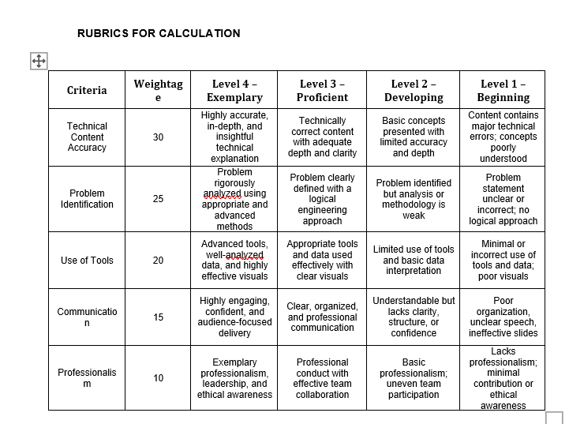
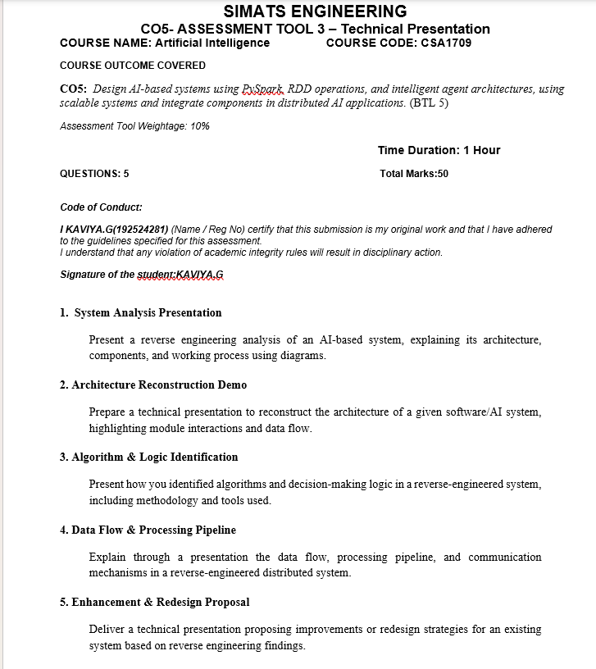

Slide 3
1. System Analysis Presentation
Reverse-engineering an AI-based system: architecture, components, and working process
WHAT WE OBSERVE
WHAT WE RECONSTRUCT
WHAT WE EXPLAIN
Inputs • outputs • screens • APIs • logs Goal: understand what the system does without relying only on its source code.
Components • models • databases • services Goal: build a clear technical picture of the hidden system.
Architecture • data flow • decisions • dependencies Goal: communicate the system in a simple, testable way.
User / Input
AI Service
Model
Database
Output
Simple idea: Observe → Map components → Trace data → Validate behavior → Document architecture
AI SYSTEM REVERSE ENGINEERING • TECHNICAL PRESENTATION
1

Slide 4
Architecture View
A typical AI application reconstructed from observable behavior
Frontend / UI
API Layer
AI / ML Engine
Data Layer
Logs
1 • INPUT
2 • PROCESS
3 • OUTPUT
User request, uploaded data, sensor/event data.
Validation → preprocessing → model inference → business rules.
Prediction, recommendation, alert, dashboard result.
Evidence sources: UI behavior, API requests, database schema, logs, configuration, model inputs/outputs.
AI SYSTEM REVERSE ENGINEERING • TECHNICAL PRESENTATION
2

Slide 5
Working Process
How the reverse-engineered AI system behaves from input to result
1 Input
2 Validate
3 Prepare
4 Infer
5 Decide
6 Respond
Data enters the system
Format & constraints checked
Clean / transform features
AI model produces result
Rules or thresholds act
Result shown to user
KEY CHECK
At each step, compare observed inputs and outputs. If the output changes when one input changes, that relationship gives evidence about the hidden logic.
AI SYSTEM REVERSE ENGINEERING • TECHNICAL PRESENTATION
3

Slide 6
Findings & Validation
A good reverse-engineering analysis separates evidence from assumptions
OBSERVED
INFERRED
VALIDATED
UI fields API calls Response format Runtime behavior
Likely modules Processing order Model type family Decision rules
Repeatable tests Edge cases Latency patterns Error behavior
Final architecture should be evidence-backed, not a guess.
Outcome: a clear map of components + responsibilities + data movement + decision points.
AI SYSTEM REVERSE ENGINEERING • TECHNICAL PRESENTATION
4

Slide 7
2. Architecture Reconstruction Demo
Reconstructing a software/AI architecture and showing module interactions
STEP 1 • COLLECT
STEP 2 • MAP
STEP 3 • CONNECT
Observe screens, endpoints, inputs, outputs and error messages.
Group evidence into UI, services, model, database and external systems.
Draw calls, dependencies and data flow; then test the map.
Reconstruction principle: every arrow should represent a real or strongly supported interaction.
AI SYSTEM REVERSE ENGINEERING • TECHNICAL PRESENTATION
1

Slide 8
Reconstructed Module Architecture
User Interface
API / Controller
Preprocessor
AI Model
Rules / Logic
Result
DATA STORE
EXTERNAL SERVICES
Features • user records • model metadata • audit logs
Authentication • maps • notification • third-party APIs
AI SYSTEM REVERSE ENGINEERING • TECHNICAL PRESENTATION
2

Slide 9
Demo: Trace One Request
Follow one request through the reconstructed architecture
Request
Validation
Feature Prep
Prediction
Response
WHAT TO RECORD
WHAT TO COMPARE
WHAT TO VERIFY
Input fields Request ID Timestamp Status code
Input → transformed features Features → model output
Same input → consistent behavior Invalid input → predictable error
AI SYSTEM REVERSE ENGINEERING • TECHNICAL PRESENTATION
3

Slide 10
Architecture Reconstruction Result
What the final technical diagram should communicate
MODULES
INTERACTIONS
DATA FLOW
Who does what?
Who calls whom?
What data moves and when?
A strong reconstruction lets another engineer understand the system without opening the original implementation.
Deliverables: architecture diagram • sequence flow • module responsibilities • assumptions • validation evidence
AI SYSTEM REVERSE ENGINEERING • TECHNICAL PRESENTATION
4

Slide 11
3. Algorithm & Logic Identification
How hidden algorithms and decision logic can be identified systematically
OBSERVE
EXPERIMENT
INFER
Inputs, outputs, timing, repeated behavior and edge cases.
Change one variable at a time and compare results.
Match behavior against known algorithm patterns and rules.
Method: Observation → Controlled test → Hypothesis → Verification
AI SYSTEM REVERSE ENGINEERING • TECHNICAL PRESENTATION
1

Slide 12
Identifying the Algorithm
Use behavior as evidence
Controlled Input
System Output
Compare Pattern
Candidate
Verify
EXAMPLE CLUES
TOOLS
CONFIRMATION
Sorted output → sorting family Shortest route → graph search Probability score → statistical/ML model
API/network inspector Logs & traces Debugger / profiler Test scripts
Test edge cases Measure complexity Repeat with new inputs
AI SYSTEM REVERSE ENGINEERING • TECHNICAL PRESENTATION
2

Slide 13
Decision Logic Identification
Separate model prediction from business rules
Input Features
ML Prediction
Threshold / Rule
Final Action
Example: Model score = 0.82 → threshold = 0.70 → action = HIGH RISK
MODEL QUESTION
RULE QUESTION
How is the prediction generated?
What condition converts the prediction into an action?
AI SYSTEM REVERSE ENGINEERING • TECHNICAL PRESENTATION
3

Slide 14
Tools & Identification Workflow
1 • Inspect
2 • Probe
3 • Measure
4 • Compare
5 • Validate
API calls, UI events, logs
Controlled test inputs
Outputs, timing, errors
Known algorithm signatures
Repeat and test edge cases
FINAL OUTPUT
Algorithm candidate + evidence + confidence level + tests that support the conclusion.
AI SYSTEM REVERSE ENGINEERING • TECHNICAL PRESENTATION
4

Slide 15
4. Data Flow & Processing Pipeline
Reverse-engineering data movement in a distributed AI system
Client
API Gateway
Service A
AI Service
Database
Output
Distributed system = multiple services cooperating through network calls and shared data.
COMMUNICATION
PROCESSING
STORAGE
HTTP/REST • JSON • events • queues
Validation • transformation • inference
Operational data • features • logs
AI SYSTEM REVERSE ENGINEERING • TECHNICAL PRESENTATION
1

Slide 16
End-to-End Data Pipeline
Collect
Validate
Transform
Infer
Store
Serve
Raw input
Check format
Create features
Run model
Persist result
Return response
DATA CONTRACT
For every interface, identify: sender → receiver → payload → protocol → response → failure behavior.
AI SYSTEM REVERSE ENGINEERING • TECHNICAL PRESENTATION
2

Slide 17
Communication & Failure Paths
The reverse-engineered map should include normal and abnormal flows
Service A
Service B
AI Service
Database
SUCCESS PATH
FAILURE PATH
TRACEABILITY
Request → processing → prediction → stored result → response
Timeout → retry → fallback → error response
Request ID → logs → service timings → final status
AI SYSTEM REVERSE ENGINEERING • TECHNICAL PRESENTATION
3

Slide 18
Data Flow Findings
A clean data-flow diagram answers four questions
WHERE FROM?
WHERE TO?
HOW?
WHAT IF?
Source of each data item.
Destination and responsible service.
Protocol and message format.
Timeout, validation and failure behavior.
Outcome: a traceable pipeline from user input to final AI result, including communication and failure handling.
AI SYSTEM REVERSE ENGINEERING • TECHNICAL PRESENTATION
4

Slide 19
5. Enhancement & Redesign Proposal
Turning reverse-engineering findings into measurable improvements
1 • FIND GAPS
2 • DESIGN
3 • MEASURE
Performance bottlenecks Security weaknesses Poor usability Duplicate processing
Refactor modules Improve APIs Optimize model/data flow
Latency • accuracy Reliability • cost User experience
Redesign should solve a demonstrated problem—not simply add more features.
AI SYSTEM REVERSE ENGINEERING • TECHNICAL PRESENTATION
1

Slide 20
Before → After Architecture
BEFORE
AFTER
UI
Monolithic AI
Database
UI
API
AI
PROBLEM
REDESIGN
One large component makes scaling, testing and debugging difficult.
Separate API, inference and data services; add monitoring and caching where justified.
AI SYSTEM REVERSE ENGINEERING • TECHNICAL PRESENTATION
2

Slide 21
Enhancement Priorities
Prioritize improvements by impact and implementation effort
Performance
Caching, batching, async processing
Reliability
Retries, timeouts, health checks
Security
Validation, access control, secrets management
AI Quality
Feature monitoring, drift checks, evaluation set
UX
Clear errors, faster feedback, explainable results
AI SYSTEM REVERSE ENGINEERING • TECHNICAL PRESENTATION
3

Slide 22
Redesign Roadmap & Expected Result
A practical sequence for implementing improvements
1 Baseline
2 Fix
3 Refactor
4 Optimize
5 Validate
6 Monitor
Measure current system
Address highest-risk gaps
Separate responsibilities
Improve latency/cost
Regression + load tests
Track quality over time
EXPECTED RESULT
Lower latency • higher reliability • easier maintenance • better AI quality • clearer user experience
AI SYSTEM REVERSE ENGINEERING • TECHNICAL PRESENTATION
4

Slide 23
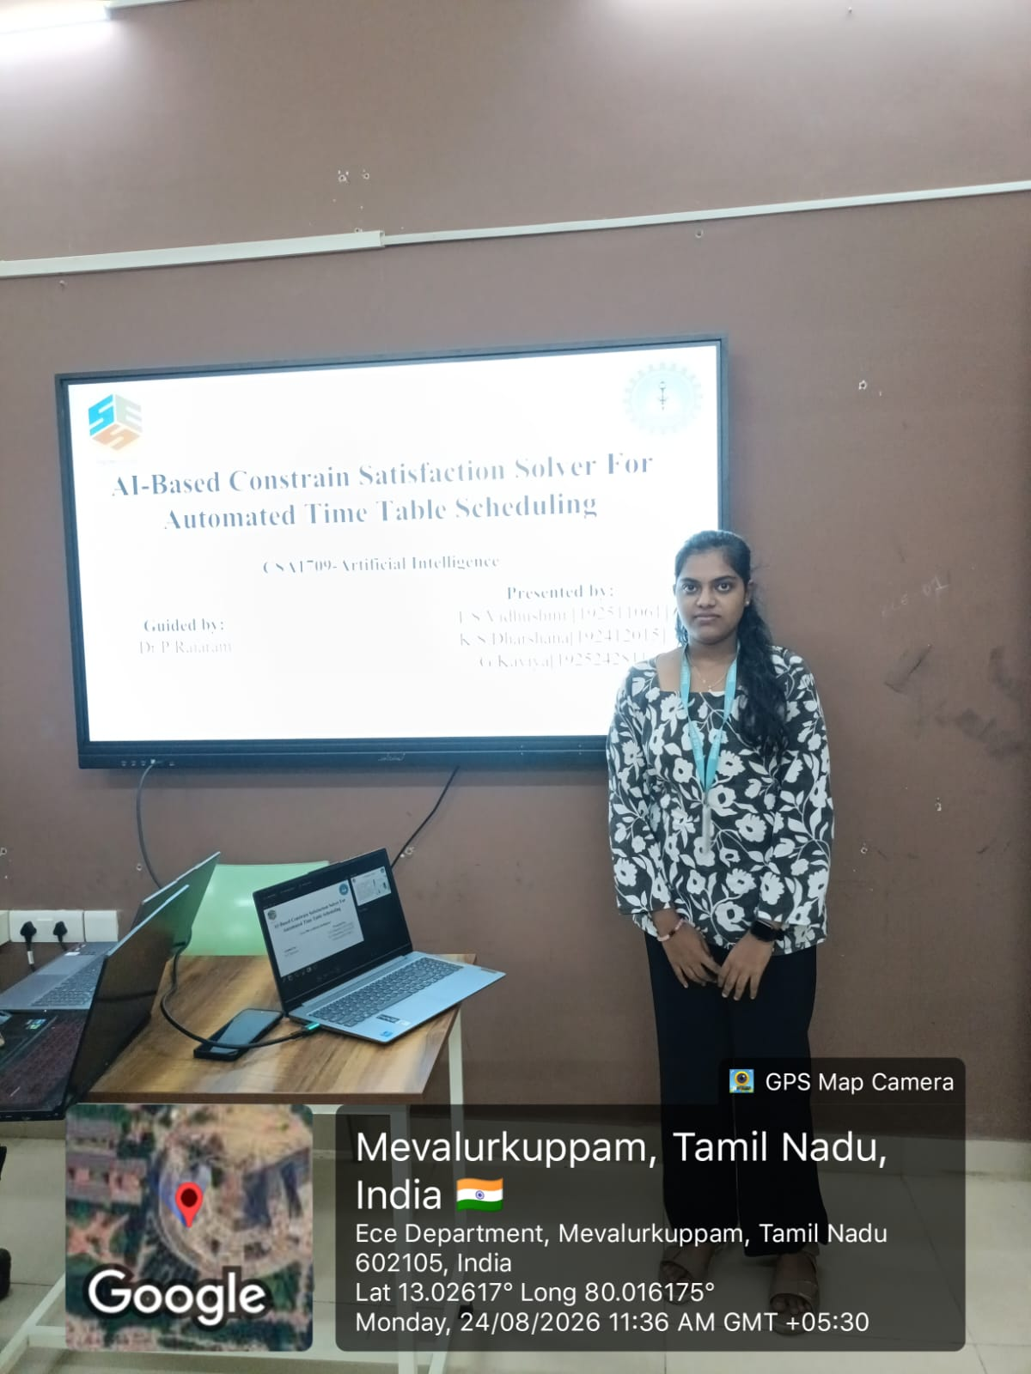
GPS PHOTO

